Slide 1
Arch Dental Associates
Tesseract Software Designs
Adam Franzen
Logical Presentation

Slide 2
Background / History
Arch Dental is a general dentistry practice with two locations, and a host of office personnel, and providers (hygienists and doctors)
The business is owned and operated by multiple partners who oversee operations
Sights set on expansion
Needs a robust computing system to help manage their business
Years painstakingly maintaining a paper business
Rooms and providers are not being used efficiently
No accurate tracking of clinic services offered
No ability to make reports on business financial/activity history

Slide 3
Environment
Arch has multiple locations
Each location has several rooms/spaces that can be utilized for patient services
Patients are scheduled for appointments and are given an estimated time to complete requested procedures
Procedures may be completed by hygienists or doctors

Slide 4
Users / Roles
Client
Provider
Admin

Slide 5
Users / Roles
Client
Primary Account Holder
View/edit household account info
View/cancel Appointments
Designate primary insurance holder
Add/edit insurance
Add/edit dependents

Slide 6
Users / Roles
Office
An office worker or provider
Create/view/update individual client account info
Create/view/cancel appointments
Generate reports
Create/view/edit qualifications

Slide 7
Users / Roles
Admin
Main partners/providers of practice
Create/view/edit any screen
Create/edit office staff and providers
Create/edit clinics
Create/edit rooms
Create/edit services
Create/edit own qualifications

Slide 8
Functional Requirements
The system shall allow the Client to:
Access account information
View Appointments (including charge history) and Profile Info

Slide 9
Functional Requirements
The system shall allow Office users to:
Create and edit client information
Create and cancel appointments
Generate reports

Slide 10
Functional Requirements
Admin
View/Update any screen
Create/Update office staff and clients
Create/Update clinics, services

Slide 11
Non-functional Requirements
The system shall function via web browser – optimized for Chrome
The system shall utilize an Oracle database
The system shall leverage IIS and asp.NET 4.0

Slide 12
Features and Benefits
Feature | Benefit
Appointments accessible from any computer | No more confusing, disorganized, and out of date paper
Real world, up to date data | No more under/over booked providers/rooms
Clients can manage their account online | Lighter workload on employees, added convenience for clients

Slide 13
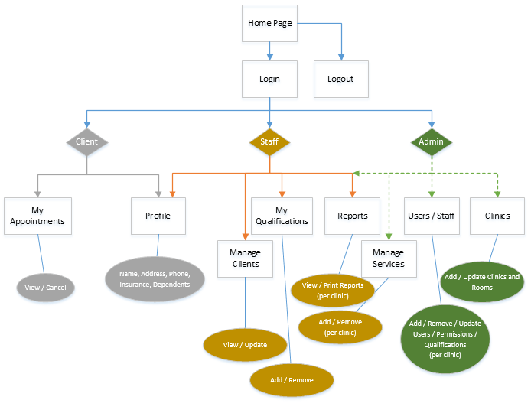
Site Diagram

Slide 14
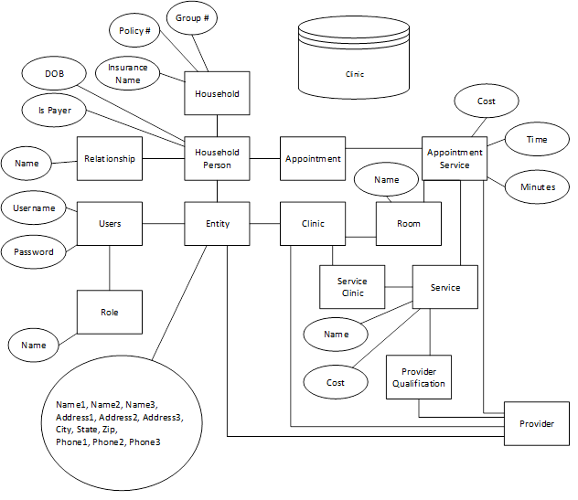
Database

Slide 15
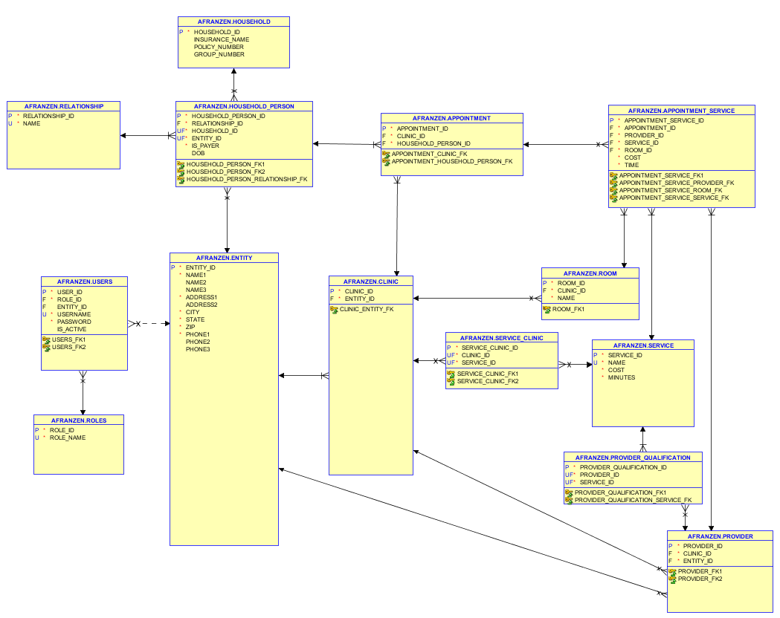
Database

Slide 16
Status (still exciting things coming)
Application in an operable state to do business
Ability to process payments coming soon!
Ability for client to create their own appointments coming soon!
Ability to print bills out online coming soon!

Slide 17
DEMO
Demo Time!

Slide 18
Summary
As things go with software, there are setbacks that force us to do one of two things to meet the deadline:
Cut Features
Risk: Could end up with a program that does nothing or is difficult to use
Sacrifice code quality/reusability for speed and efficiency
Risk: Not easy to add enhancements later
Bugs and enhancements cost SIGNIFICANTLY more!
We did our best to maintain a balance between these two in order to provide you the best, most usable product we could in the time give.

Slide 19
Questions???
?

